Slide 1
From Awareness to Action: the Military Family in Our Communities
Prepared by:
Ann Domsch, Kansas OMK Coordinator
Dr. Elaine Johannes, School of Family Studies and Human Services – Youth Development
Dr. Charlotte Olsen, School of Family Studies and Human Services – Family Development

Slide 2
After this session, we will. . .
Understand military family life and culture.
Understand how deployment and training cycles present challenges, reveal attributes and foster resilience among military families.
Identify supports and resources necessary for military families to thrive.
Commit to one tangible, sustainable act of support for families.
Notes:
Many families in our communities have experienced the strain of lengthy wartime deployments. According to a 2011 White House report nearly 2 million children in the United States have parents who are military service members. In Kansas, over 33,000 children have a currently parent serving in the military, and these children live in small towns and rural areas as well as cities. The military families in our communities have faced multiple and prolonged deployments. Many of these families, though thankful that their loved one is no longer deployed, must cope with the strain of new roles and responsibilities associated with the reintegration of a returned service member .
Reintegration is not always easy and it requires time, understanding and intentional efforts of each family member. This is where individuals, neighborhoods and whole communities can help. By providing military families with timely opportunities to acclimate, adjust and discover a “new normal”, community members can help strengthen families.
This presentation will help civilian audiences understand and then act to support military family members thrive after deployment.

Slide 3
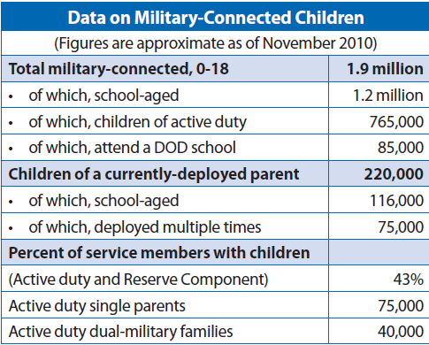
Who are Army Guard and Reserve Members and Families?
55% Married
48.3% Never Married Parents
7.3% Divorced
.2% Other (widowed, annulled)
43.2% with Children
56.8% without Children
www.militaryhomefront.dod.mil, 2010
www.defense.gov/home/features/2011/0111_initiative/strengthening_our_military_january_2011.pdf
Notes:
More than any other time in our nation’s history, military service members are now more likely to be parents of children. Though single military members still comprise a large portion of service members, nearly 2 million children are growing up in families where at least one parent serves in the military. According to the White House Report, “Strengthening our Military Families” (2011),
“Less than 1 percent of Americans serve in uniform today, but they bear 100 percent of the burden of defending our Nation. Currently, more than 2.2 million service members make up America’s all-volunteer force in the active, National Guard, and Reserve components. Since September 11, 2001, more than two million troops have been deployed to Iraq and Afghanistan.
Fifty-five percent of the force is married and 40 percent have two children. Only 37 percent of our families live on military installations; the remaining 63 percent live in over 4,000 communities nationwide. Multiple deployments, combat injuries, and the challenges of reintegration can have far-reaching effects on not only the troops and their families, but also upon America’s communities. These challenges should be at the forefront of our national discourse,” (pg.4).

Slide 4
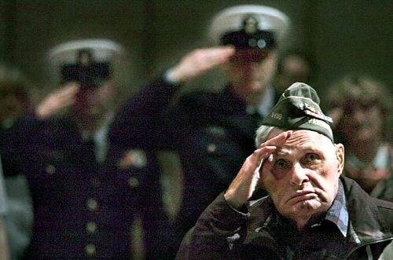
Military Culture
Culture is the knowledge,
experience, values, ideals,
attitudes, and symbols that
are passed on from more
experienced members of a
community to new members.
Notes:
Typically, the challenges of deployments and reintegration are buffered by the military lifestyle and culture which provide stability, consistency and support. However, if the family is isolated from that culture due to physical, social or emotional distance, the military culture can become a barrier to accepting community support. Most military families take pride in their self-sufficiency, and don’t often seek help. This resilience serves them well in times of stress, but can be misinterpreted as being aloof or uncooperative.
Understanding military culture is important since it is in this context that military families earn their livelihoods and build their identity. Demonstrating respect for and interest in the military cultural will help civilians establish friendships and relationships with military families. One of the most important aspects of the military culture is the military's mission. In the military, the mission is considered to be more important than personal safety or family well-being.
The mission of the Army is to preserve the peace and security and provide for national defense. Army active and reserve components, such as the National Guard, work to support our national policies, implement national objectives, and overcome aggressive acts that are dangerous to the United States.
It’s important to know the mission of the military because that mission motivates service members to endure long deployments, risk of injury and death. However, many members join the military for reasons of job security, job skills and benefits. Consequently, military families may experience some conflict between what is expected of them by the military and what they want.

Slide 5
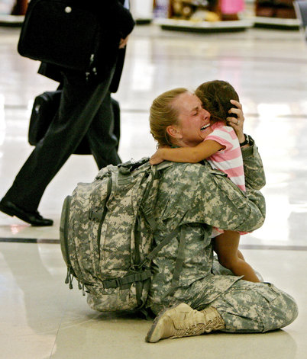
What Prevents Families
From Seeking Help?
Lack of community awareness.
Civilians are typically not prepared to
recognize or meet the needs of military-families.
Civilians are unfamiliar with resources of help.
Deployments and trainings repeatedly disrupt families.
Families are often hesitant to ask for help.
Notes:
In addition to the potential strain between what the military expects and what the family wants, there are unique challenges to military families and the communities that wish to support them.
Many community members are unaware of military families living in the community. Though our nation has been at war for over 10 years, many citizens don’t experience the military in their daily lives. Though veterans live in communities, they may not be familiar with the unique issues and challenges that recent wars created. For example, along with long, multiple, hazardous deployments, military families have coped with economic insecurity, frequent moves, and fluctuating services and benefits. These strains are amplified if both parents are deployed or serve in the military at the same time. Long and frequent separations from parents have been found to have negative impacts on children of all ages even if grandparents or other relatives take care of children in the parent’s absence.

Slide 6
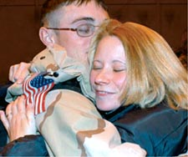
Emotional Deployment Cycle of Military Families
Seven Stages:
1. Anticipation of departure
due to deployment or training
2. Detachment and withdrawal
3. Emotional disorganization, anxiety
4. Family recovers, stability
5. Anticipation of return
6. Adjustment and renegotiation of roles and routines at return
7. Reintegration and stability until the next deployment
www.hooah4health.com
Notes:
Even with these challenges , it is a joyous time for many military families . The wars are winding down and many families are being reunited with their loved ones.
Most people have not thought about how return home of soldiers have affected families. A roller-coaster of emotions often accompany the return of service members. In addition to emotional transitions, specific roles and responsibilities in the family have to be renegotiated and reassigned. During these times it’s important that family members communicate, connect and maintain flexibility since successful reintegration takes many months and possibly years.

Slide 7
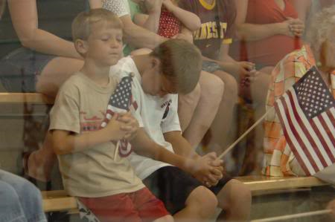
Military Families Want (need) . . .
To link with other military families
Understanding, respect, compassion, empathy
To spend time with their loved ones
Understanding if they don’t want to talk
Silent support
(Ks. National Guard Youth Council, Feb. , 2011)

Slide 8
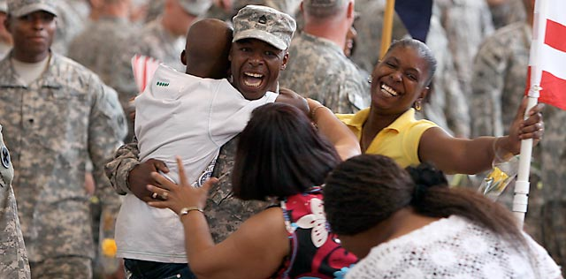
Communities Can: Foster Strong Families
Communicate resiliency
Focus on strengths more than criticize weaknesses
Build circles of support around each family member
Be appropriate; know when to “stand down”,
and don’t give up!
Notes:
One of the primary ways communities can help military families through reintegration is to focus on fostering strong families. This is an important point to keep in mind when planning community-wide recognitions and events for military families. Most military families move through the reintegration process well. Individual members and the family as a whole are resilient and strong thanks to their military culture, web-based social networks, and acceptance of the military mission.
However, military families who are at-risk due to too many transitions, stressors and demands, would benefit from having access to community circles of support.

Slide 9
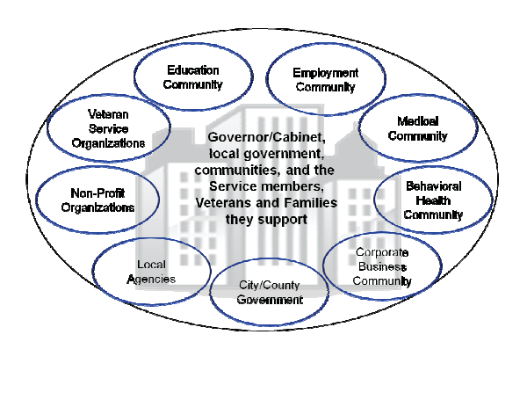
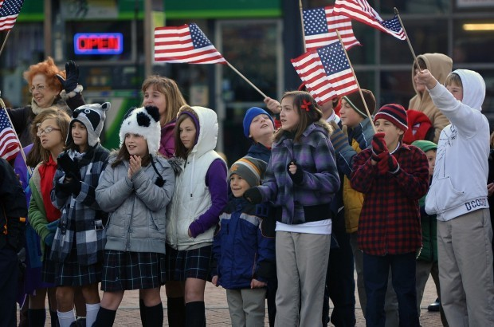
Communities Can: Create Circles
of Support
Notes:
Communities can strengthen and develop support programs and networks. These networks can leverage resources in support of military families. Community networks also promote a sense of community spirit and pride as they support families, Veterans, and Wounded Warriors. Military families contribute to our nation and our communities.
According to the White House report on “Strengthening our Military Families” (2011), “For years to come, military families and Veterans will continue to face unique challenges [associated with over 10 years of war], and at the same time will also have great potential to continue contributing to our communities and country,” (pg. 5).

Slide 10
Communities Can: Support Reintegration
Seek to improve family communication, which enhances family connection (cohesion) and leads to individual and family adaptability (Olson, D., 2000)
If necessary, honestly acknowledge problems and challenges; offer to help seek options, solutions.
How can our community build on the strengths of military families and culture to support reintegration?

Slide 11
We Can - Get Involved!
Show support through Action. . .
Provide transportation
Sponsor a support network
Organize a day to help with yard work
Do simple things that make a tangible difference
Volunteer
Listen
I will ________________
Notes:
Ideas for Community Activities include:
Planting "Welcome Home" and "Thank You" gardens and trees
Holding childcare trainings for teens
Asking military families to tell us what they need and want
Volunteering to babysit so parents can have time together
Helping with (outside, inside) household chores
Offering to read to children while parents have some alone time
Purchasing books for school libraries about the military family experience
Volunteering to do run errands
Dropping off a home-cooked meal
Teaching board games at an Extension Family Game Night
Listening to military-connected youth
Producing a play by military-connected youth
Connecting families to helpful community organizations
Providing opportunities for military families to strengthen communication and connections
Inviting family members to take walks

Slide 12
Learn More. . .
Military Homefront –
www.militaryhomefront.dod.mil/
OMK
(Operation Military Kids) –
www.operationmilitarykids.org
Military One Source –
www.militaryonesource.com
Military Child Education Coalition –
www.militarychild.org

